Slide 1

UNIVERSITY INSTITUTE OF ENGINEERING
COMPUTER SCIENCE ENGINEERING
Bachelor of Engineering (Computer Science & Engineering)
Subject Name: Internet of Things
Subject Code: 20CST-357
Smart Homes & Beyond Syllabus
DISCOVER . LEARN . EMPOWER

Slide 2
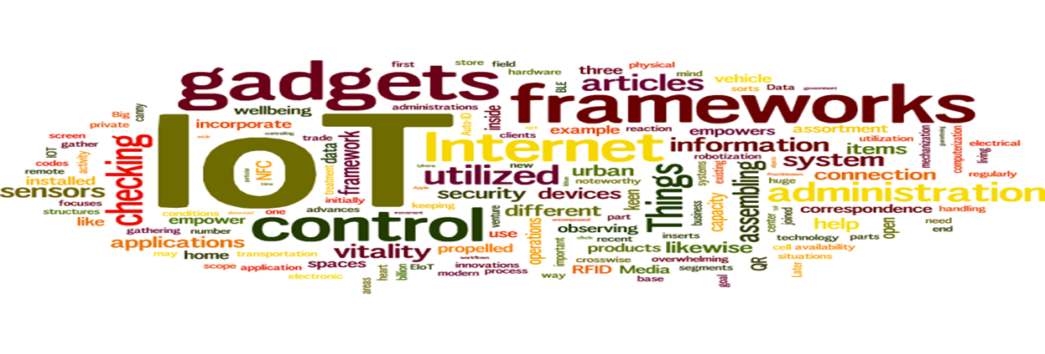
Internet of Things
Course Outcomes:
1. Analyze the basic terminologies associated with IoT and use it.
2. Justify the applications of internet of things and correlate them.
3. Compare different objects and communication strategies and also able to see the issues raised by communication strategies in IoT.
4. Examine the protocols required for communication and packet size required for each application.
5. Illustrate security issues with IoT like security, privacy, communication standard and some other legal issues.

Slide 3
UNIT 3 CHAPTER 7 Smart Homes & Advanced Topics

Slide 4
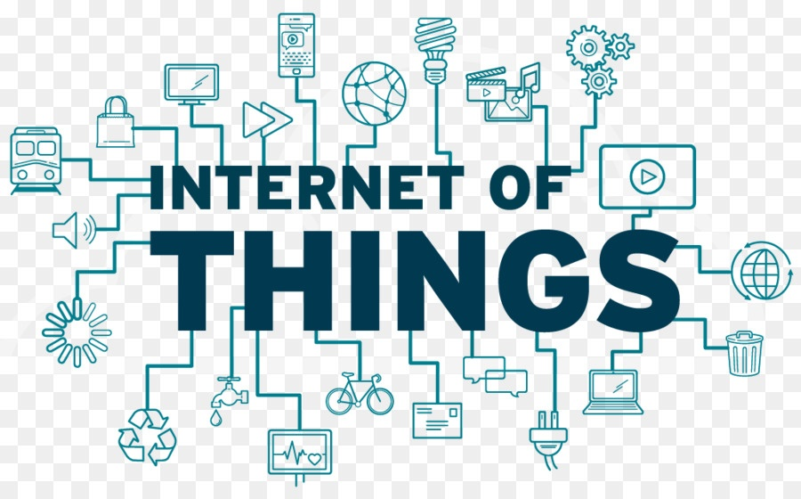
Internet of Things
Chapter-7 (Case Study)
Case study on smart homes using Internet of Things.
ADVANCED TOPICS (BEYOND SYLLABUS)
Mobile Cloud Services
IoT and Cloud Security
Smart Cloud and IOT

Slide 5
Smart Homes using IoT (CO-2)
The home can be called smart when it has a range of smart devices that you can control remotely by setting them the way you like to automatize house maintenance. They can also be united into one network. For example, the lights can turn on at the moment you enter the home (lamps will know it from the sensors) or your vacuum cleaner can start cleaning every day at 11 AM.
But the true magic starts when IoT (Internet of Things) joins this team. It provides all the devices with internet access which broadens the possibilities of such a home network. For instance, now you can see what happens in your house watching security cameras through your smartphone or computer. IoT applications allow you connecting devices to each other and letting them communicate without your participation. Imagine this: the moment your car leaves the parking near the office, the conditioner starts cooling your house so that after a hot day you could enter a pleasantly cool home.

Slide 6
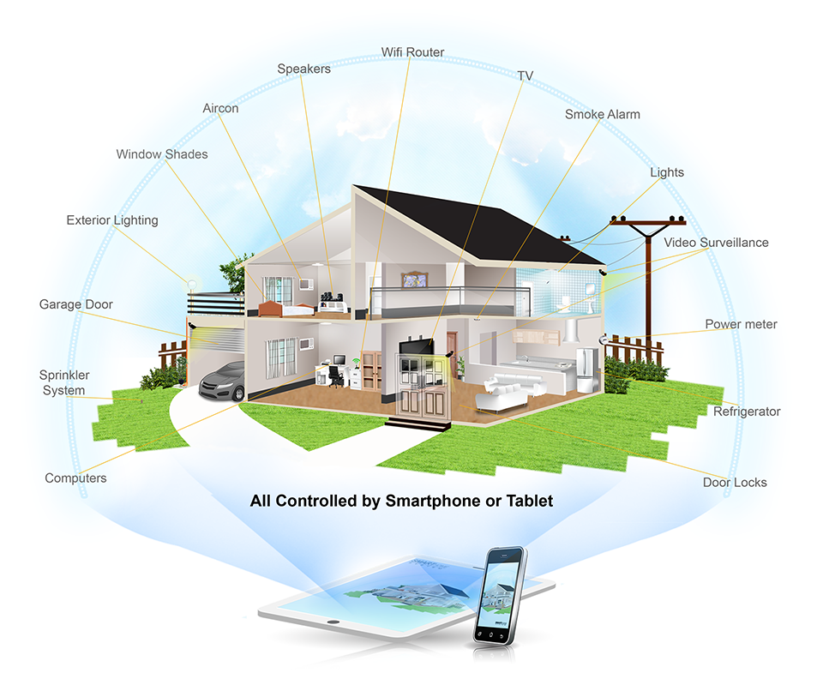

Slide 7
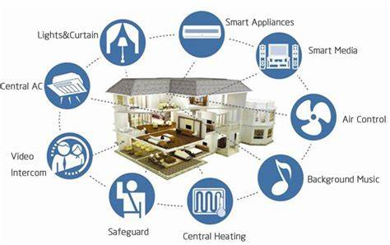

Slide 8
Benefits of IoT Smart Home Technologies
The cool house on a hot day far not the only profit you get. Let’s now see the most significant benefits of the IoT smart home applications.
1. Control and Monitoring
2. Cost and Energy Savings
3. Environment Impact
4. Better Security
5. Comfort

Slide 9
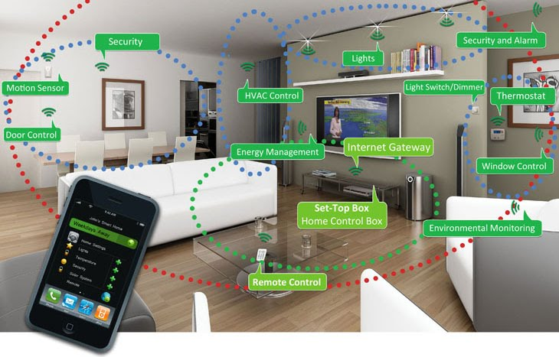

Slide 10
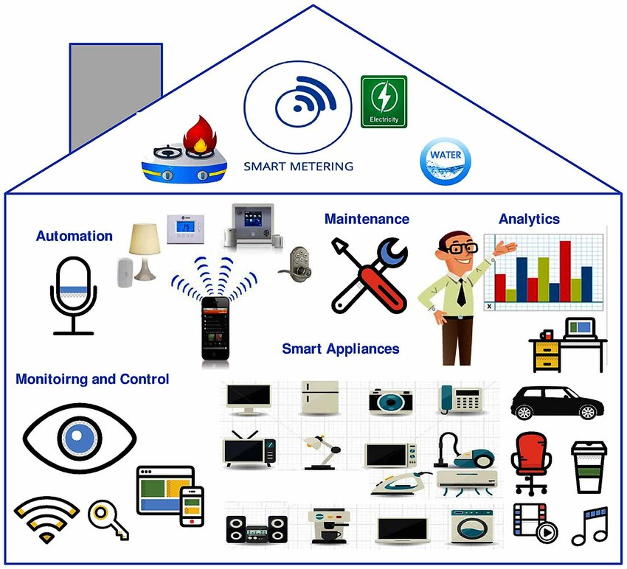

Slide 11
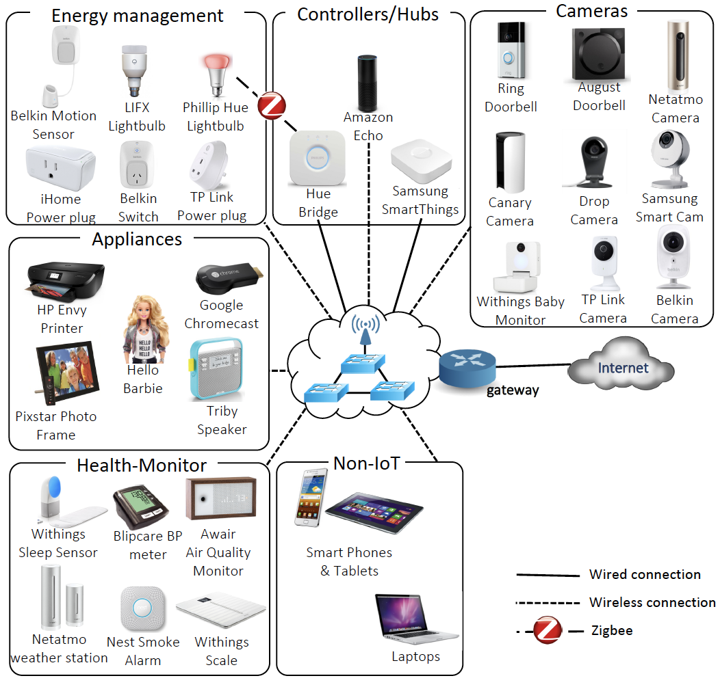

Slide 12
Advanced Topics Beyond Syllabus

Slide 13
Mobile Cloud Services (CO-3)
Mobile cloud services mean when a mobile phone interacts with the cloud. Mobile cloud services enable a user for an amazing experience on mobile phones which consists of the best components. The main components are cloud technology, mobile computing, and wireless network. This also enables a mobile user and other network operators a great opportunity to explore. Internet of Things has become a major component for controlling devices using data in the cloud. The users always tend to find services that are easy to access and therefore mobile cloud services have become very famous. Data of several sensors or other components can easily be tracked using a mobile phone just like how it’s done on desktop or other devices.

Slide 14
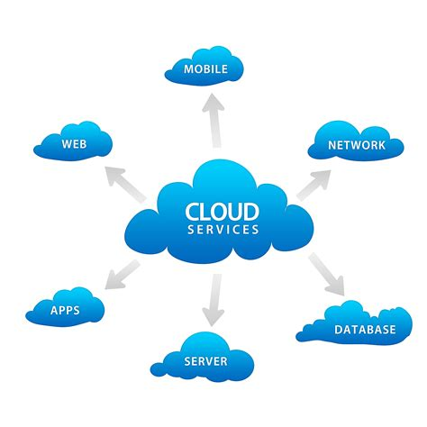

Slide 15
Advantages of Mobile Cloud Services:
1. Several features are present on mobile phones which is a great factor for developers and mobile phone users.
2. Many new developers can easily start making projects using mobile cloud services for the Internet of Things.
3. These mobile services help developers reach greater markets and give a lot of profit to several companies.
4. Therefore, Due to its portability, it is very user friendly and it proves itself to be efficient.
5. Several companies save a lot of money as they are not forced to pay a huge amount for these services.

Slide 16
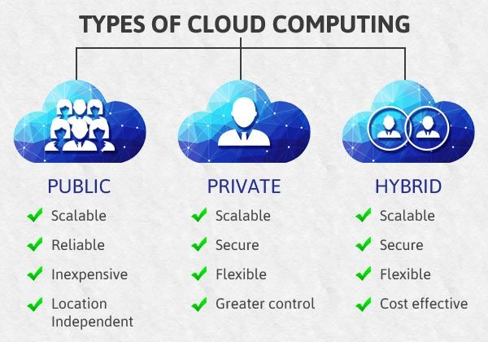

Slide 17
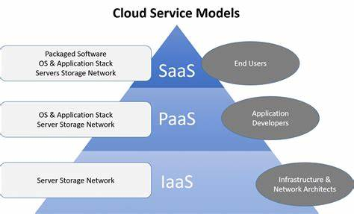

Slide 18
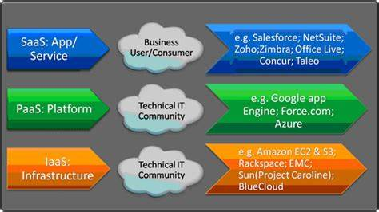

Slide 19
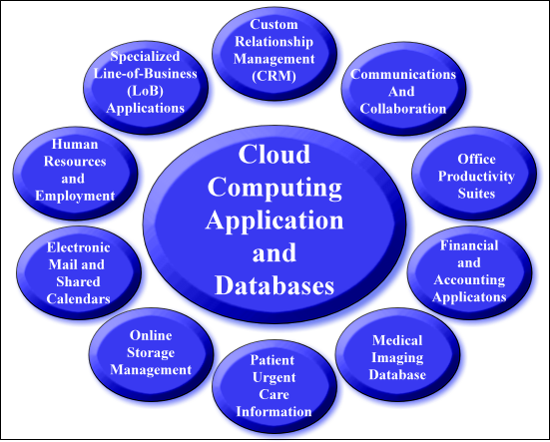

Slide 20
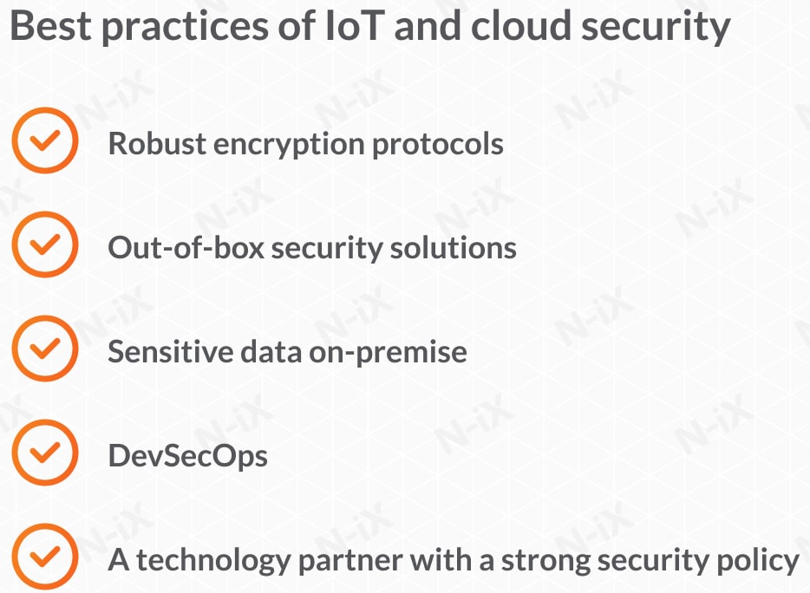
IoT and Cloud Security (CO-5)

Slide 21
FIVE BEST PRACTICES TO ENSURE IOT AND CLOUD SECURITY
A. Encrypt your data
1. Azure Security Center by Microsoft
2. AWS Security Hub by Amazon
3. Cloud Security Command Center by Google
B. Leave sensitive data on-premises
C. Use DevSecOps approach
D. Choose an IoT development partner with an established security policy

Slide 22
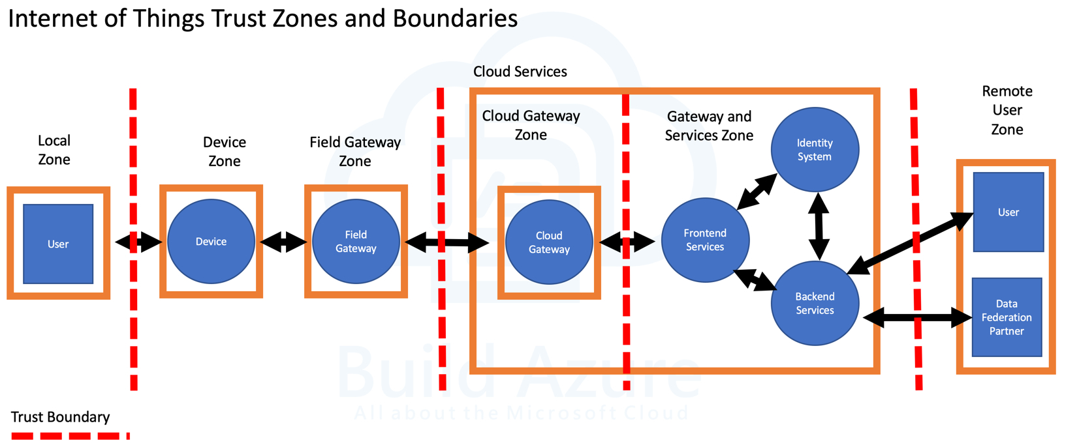

Slide 23
5 Ways to Secure IoT in any Enterprise:
Employ device discovery for visibility across the board
Actively Monitor IoT Devices
3. Carefully configure your router
4. Adopt Secure Password Practices
5. Keep an eye on vendor & supplier IoT practices

Slide 24
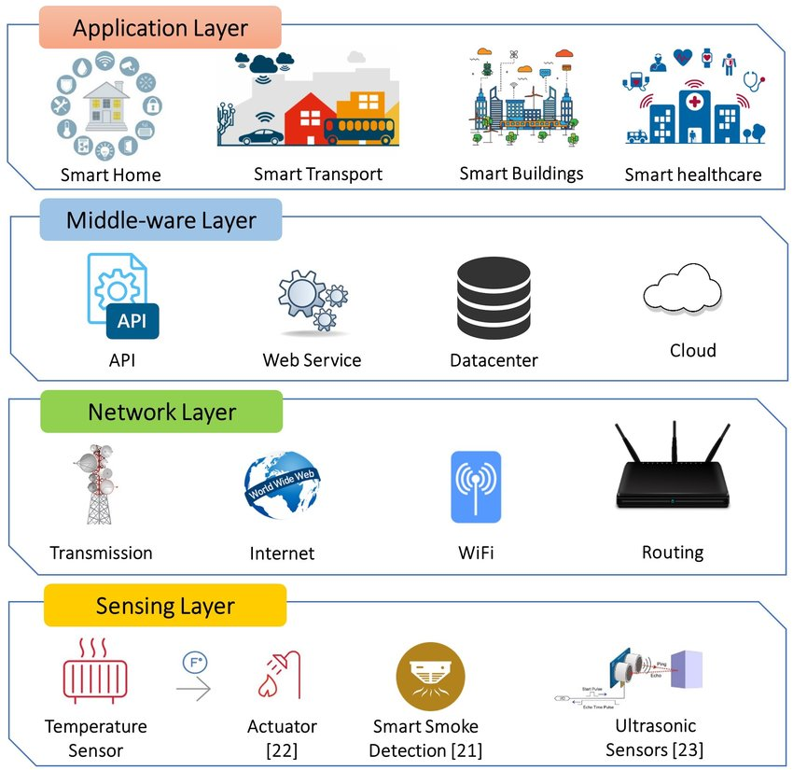

Slide 25
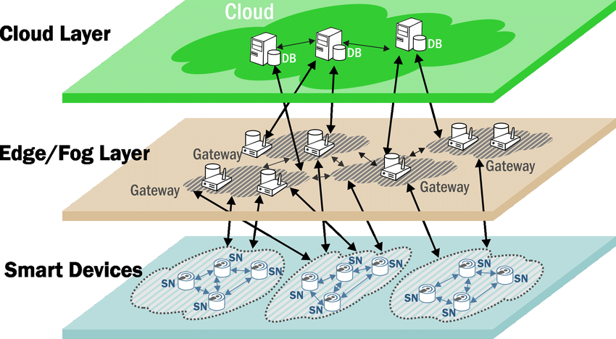
Smart Cloud and IoT (CO-3)

Slide 26
Cloud Computing can be defined as the practice of using a network of remote servers hosted on the Internet to store, manage, and process data, rather than a local server or a personal computer. Companies offering such kinds of cloud computing services are called cloud providers and typically charge for cloud computing services based on usage. Grids and clusters are the foundations for cloud computing.

Slide 27
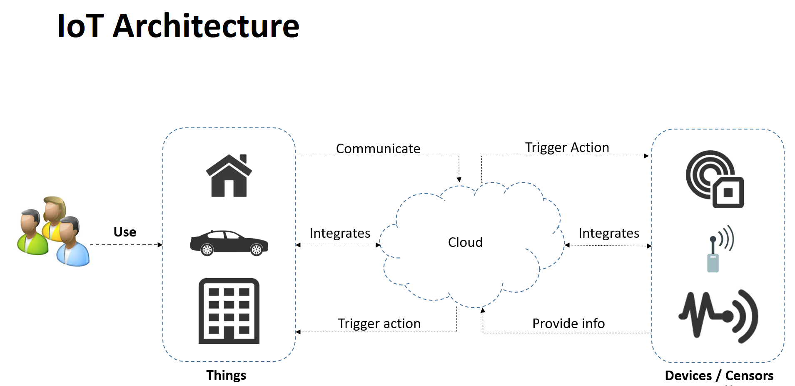

Slide 28
Types of Cloud Computing:
Most cloud computing services fall into five broad categories:
1. Software as a service (SaaS)
2. Platform as a service (PaaS)
3. Infrastructure as a service (IaaS)
4. Anything/Everything as a service (XaaS)
5. Function as a Service (FaaS)

Slide 29
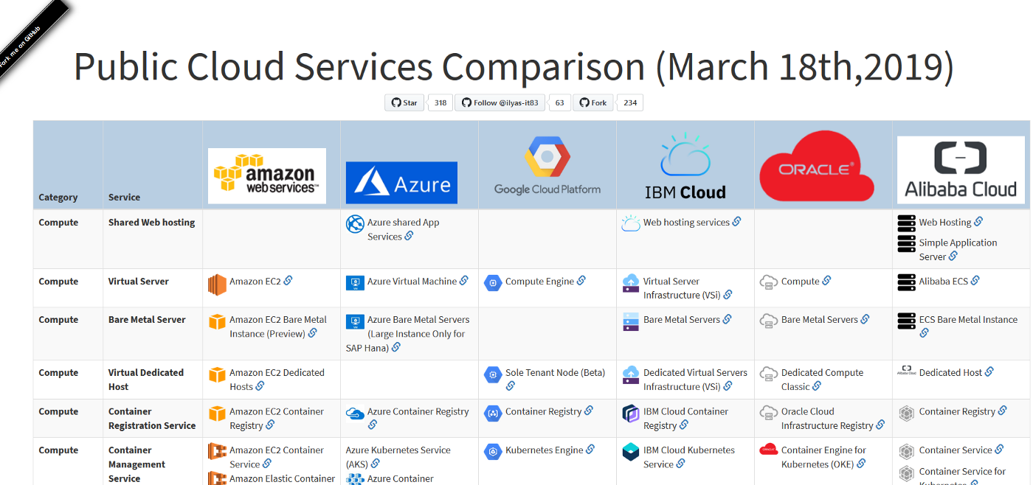

Slide 30
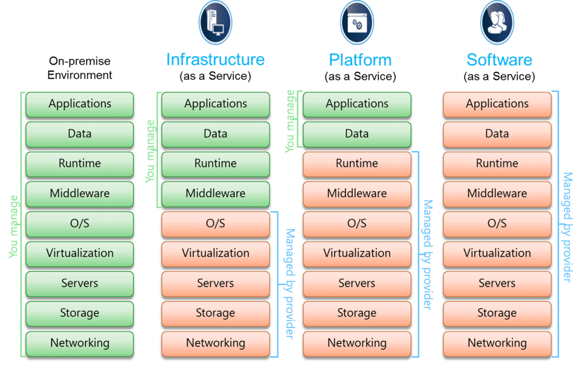

Slide 31
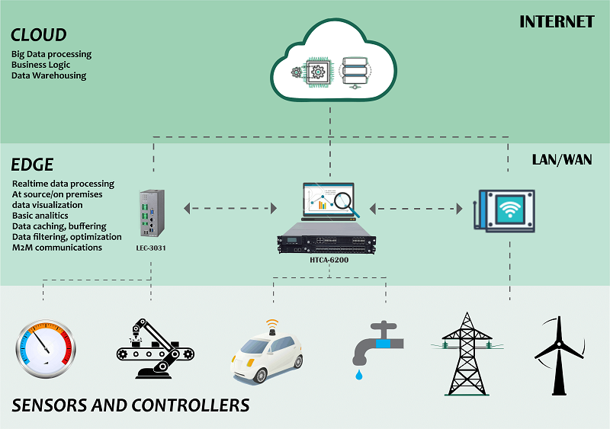

Slide 32
Summary
Smart homes can feature either wireless or hardwired systems—or both. Wireless systems are easier to install. Putting in a wireless home automation system with features such as smart lighting, climate control, and security can cost several thousand dollars, making it very cost-friendly.
The downside to wireless systems is you likely need strong Wi-Fi coverage and broadband service throughout your entire house. This may require you to invest in range extenders or hardwired wireless access points. Wireless smart home systems are generally more appropriate for smaller existing homes or rental properties due to their smaller size.
Hardwired systems, on the other hand, are considered more reliable and are typically more difficult to hack. A hardwired system can increase the resale value of a home. In addition, hardwired smart home systems can easily be scaled; therefore, it is often the default method when designing a new build or performing a major renovation.
There is a drawback—it's fairly expensive. Installing a luxury and hardwired smart system can cost homeowners tens of thousands of dollars. In addition, you must have space for network hardware equipment including Ethernet cables.

